Slide 1
CHAPTER - 5
Analog Transmission
Part-2

Slide 2
Phase Shift Keying
In phase shift keying, the phase of the carrier is varied to represent two or more different signal elements.
Both peak amplitude and frequency remain constant as the phase changes.

Slide 3
Binary PSK (BPSK)
The simplest PSK is binary PSK, in which we have only two signal elements, one with a phase of 0°, and the other with a phase of 180°.
    Bit 1 = phase 0°
    Bit 0 = phase 180°
Binary PSK is as simple as binary ASK with one big advantage—it is less susceptible to noise.
In ASK, the criterion for bit detection is the amplitude of the signal; in PSK, it is the phase.

Slide 4

Cont.
Noise can change the amplitude easier than it can change the phase. In other words, PSK is less susceptible to noise than ASK.
PSK is superior to FSK because we do not need two carrier signals. However, PSK needs more sophisticated hardware to be able to distinguish between phases.

Slide 5
Bandwidth
The bandwidth is the same as that for binary ASK, but less than that for BFSK. No bandwidth is wasted for separating two carrier signals.

Slide 6
Implementation
The implementation of BPSK is as simple as that for ASK. The reason is that the signal element with phase 180° can be seen as the complement of the signal element with phase 0°.
This gives us a clue on how to implement BPSK. We use the same idea we used for ASK but with a polar NRZ signal instead of a unipolar NRZ signal.
The polar NRZ signal is multiplied by the carrier frequency; the 1 bit (positive voltage) is represented by a phase starting at 0°; the a bit (negative voltage) is represented by a phase starting at 180°.

Slide 7

Cont.
Bit 1 = phase 0°
Bit 0 = phase 180°
Figure 5.10 Implementation of BASK

Slide 8
Quadrature PSK (QPSK)
The simplicity of BPSK enticed designers to use 2 bits at a time in each signal element, thereby decreasing the baud rate and eventually the required bandwidth.
The scheme is called quadrature PSK or QPSK because it uses two separate BPSK modulations; one is in-phase, the other quadrature (out-of-phase).
The incoming bits are first passed through a serial-to-parallel conversion that sends one bit to one modulator and the next bit to the other modulator.
If the duration of each bit in the incoming signal is T, the duration of each bit sent to the corresponding BPSK signal is 2T. This means that the bit to each BPSK signal has one-half the frequency of the original signal.

Slide 9

Cont.
Figure 5.11 QPSK and its implementation

Slide 10
Cont.
The two composite signals created by each multiplier are sine waves with the same frequency, but different phases.
When they are added, the result is another sine wave, with one of four possible phases: 45°, −45°, 135°, and −135°.
There are four kinds of signal elements in the output signal (L = 4), so we can send 2 bits per signal element (r = 2).

Slide 11
Cont.
Example 5.7
  Find the bandwidth for a signal transmitting at 12 Mbps for QPSK. The value of d = 0.
Solution:
  For QPSK, 2 bits are carried by one signal element. This means that r = 2. So the signal rate (baud rate) is
  S = N × (1/r) = 6 Mbaud. With a value of d = 0, we have B = (1+d)S
  B = (1+0) × S = S = 6 MHz.

Slide 12

Constellation Diagram
semester
A constellation diagram can help us define the amplitude and phase of a signal element, particularly when we are using two carriers (one in-phase and one quadrature).
The diagram has two axes. The horizontal X axis is related to the in-phase carrier; the vertical Y axis is related to the quadrature carrier.
Figure 5.12 Concept of a constellation diagram

Slide 13
Cont.
For each point on the diagram, four pieces of information can be deduced.
  (1).The projection of the point on the X axis defines the peak amplitude of the in-phase component.
  (2). The projection of the point on the Y axis defines the peak amplitude of the quadrature component.
  (3). The length of the line (vector) that connects the point to the origin is the peak amplitude of the signal element (combination of the X and Y components);
  (4). The angle the line makes with the X axis is the phase of the signal element.

Slide 14

Cont.
Example 5.8
Show the constellation diagrams for ASK (OOK), BPSK, and QPSK signals.
Solution
Figure 5.13 shows the three constellation diagrams. Let us analyze each case separately:

Slide 15
Quadrature Amplitude Modulation
semester
PSK is limited by the ability of the equipment to distinguish small differences in phase. This factor limits its potential bit rate. So far, we have been altering only one of the three characteristics of a sine wave at a time; but what if we alter two? Why not combine ASK and PSK? The idea of using two carriers, one in-phase and the other quadrature, with different amplitude levels for each carrier is the concept behind quadrature amplitude modulation (QAM).
Quadrature amplitude modulation is a combination of ASK and PSK.

Slide 16
Cont.
The possible variations of QAM are numerous. Figure 5.14 shows some of these schemes.
Part a, shows the simplest 4-QAM scheme (four different signal element types) using a unipolar NRZ signal to modulate each carrier. This is the same mechanism we used for ASK (OOK).
Part b, shows another 4-QAM using polar NRZ, but this is exactly the same as QPSK.
Part c, shows another QAM-4 in which we used a signal with two positive levels to modulate each of the two carriers.
Finally, Part d, shows a 16-QAM constellation of a signal with eight levels, four positive and four negative.

Slide 17

Cont.
Figure 5.14 Constellation diagrams for some QAMs

Slide 18
Bandwidth for QAM
The minimum bandwidth required for QAM transmission is the same as that required for ASK and PSK transmission.

Slide 19
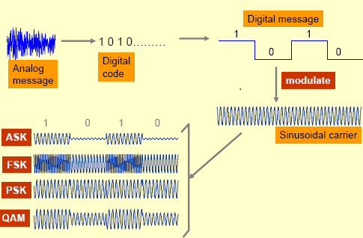
Summarize

Slide 20
Real life Application of
Digital-to-Analog conversion
H.W

Slide 21
5.2 Analog-to-analog conversion
Analog-to-analog conversion, or analog modulation, is the representation of analog information by an analog signal.
Analog-to-analog conversion can be accomplished in three ways:
  (1). Amplitude modulation (AM)
  (2). Frequency modulation (FM)
  (3). Phase modulation (PM)
FM and PM are usually categorized together.

Slide 22

Cont.
Figure 5.15 Types of analog-to-analog modulation

Slide 23
Amplitude Modulation
semester
In AM transmission, the carrier signal is modulated so that its amplitude varies with the changing amplitudes of the modulating signal.
The frequency and phase of the carrier remain the same; only the amplitude changes to follow variations in the information.

Slide 24

Cont.
semester
Figure 5.16 Amplitude modulation

Slide 25
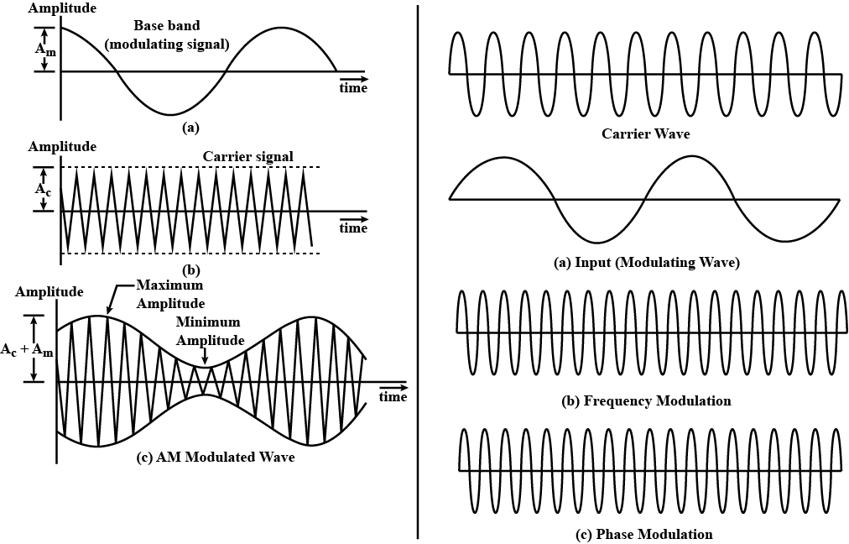
Cont.

Slide 26
Amplitude Modulation
m(t) = Modulating / Message signal
= A_{m}*sin ω _{m}(t) ----------(i). [ω_{m} =2*pi*f_{m}]
c(t) = Carrier signal
= A_{c}*sin ω _{c}(t) ---------(ii). [ω_{c} =2*pi* f_{c}]
y(t) = Modulated signal
=A*sin ω_{c}(t) ------------(iii).
Where, A = A_{c} +m(t) ----------(iv).
Substitute equation (1) in equation (iv).
A = A_{c} + A_{m}*sin ω _{m}(t)
= A_{c} {(1+ (A_{m} /A_{c}) sin ω_{m}(t)}
= A_{c}{(1+ µ sin ω_{m}(t)} [Where, µ = (A_{m} /A_{c}) =Modulation Index]

Slide 27
Cont.
Substitute equation (iv) in equation (iii).
y(t) = A_{c}{(1+ µ sin ω_{m}(t)} sin ω_{c}(t)
= A_{c} sin ω_{c}(t) + µ A_{c} sin ω_{c}(t) sin ω_{m}(t)
= A_{c} sin ω_{c}(t) + (µ A_{c} /2) {cos (ω_{c}-ω_{m})t - cos (ω_{c}+ω_{m})t}
[SinA SinB = ½ [Cos (A-B) – Cos (A+B)]
y(t) = A_{c} sin ω_{c}t + { (µ A_{c} /2) (cos (ω_{c}-ω_{m})t } - { (µ A_{c} /2) cos (ω_{c}+ω_{m})t}.
Here, ω_{c} = Carrier frequency
(ω_{c}-ω_{m}) = Lower side band (LSB) frequency
(ω_{c}+ω_{m}) = Upper side band (USB) frequency
A_{c} = Carrier amplitude
(µ A_{c} /2) = Lower side band (LSB) amplitude
(µ A_{c} /2) = Upper side band (USB) amplitude

Slide 28
Cont.
USB/ LSB amplitude = (µ A_{c} /2)
= (A_{c} /2) * µ
= (A_{c} /2) * (A_{m} / A _{c})
₌ (A_{m} / 2)

Slide 29
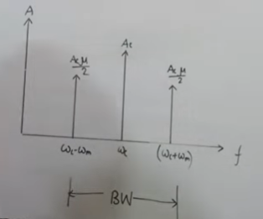
Cont.
Frequency spectrum
Carrier frequency = ω_{c}
Lower side band (LSB) frequency = (ω_{c}-ω_{m})
Upper side band (USB) frequency = (ω_{c}+ω_{m})

Slide 30
Cont.
(ω_{c}-ω_{m}) = Lower side band (LSB) frequency
(ω_{c}+ω_{m}) = Upper side band (USB) frequency
BW= USB frequency-LSB frequency
= (ω_{c}+ω_{m}) -(ω_{c}-ω_{m})
= 2 ω_{m}

Slide 31
Standard Bandwidth Allocation for AM Radio
H.W
(Book)

Slide 32
Frequency Modulation
In FM transmission, the frequency of the carrier signal is modulated to follow the changing voltage level (amplitude) of the modulating signal.
The peak amplitude and phase of the carrier signal remain constant, but as the amplitude of the information signal changes, the frequency of the carrier changes correspondingly.
FM is normally implemented by using a voltage-controlled oscillator as with FSK. The frequency of the oscillator changes according to the input voltage which is the amplitude of the modulating signal.

Slide 33

Cont.
Figure 5.18 Frequency modulation

Slide 34
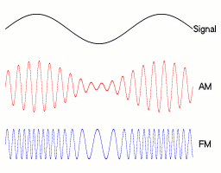
Cont.

Slide 35
Standard Bandwidth Allocation for FM Radio
H.W
(Book)

Slide 36
Phase Modulation
In PM transmission, the phase of the carrier signal is modulated to follow the changing voltage level (amplitude) of the modulating signal.
The peak amplitude and frequency of the carrier signal remain constant, but as the amplitude of the information signal changes, the phase of the carrier changes correspondingly.
It can proved mathematically that PM is the same as FM with one difference. In FM, the instantaneous change in the carrier frequency is proportional to the amplitude of the modulating signal; in PM the instantaneous change in the carrier frequency is proportional to the derivative of the amplitude of the modulating signal.

Slide 37

Cont.
Figure 5.20 Phase modulation

Slide 38
Real life Application of
Analog-to-Analog conversion
H.W

